Slide 1




CoMSES Net: Promoting reproducibility, transparency, and knowledge sharing in computational social ecological systems science
Michael Barton, Marco Janssen, Allen Lee, Christine Nguyen, Calvin Pritchard
Global Biosocial Complexity Initiative, Arizona State University

Slide 2
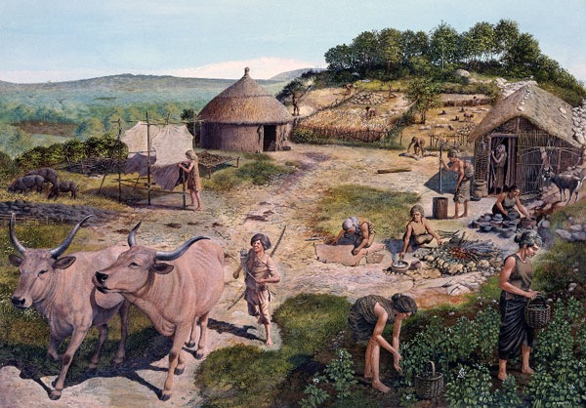
Need for Computational Modeling in SES Science
A few centuries ago, most people lived in small communities
An individual could…
observe relevant social and natural phenomena and
intuit the consequences of their actions on fellow humans and the natural world
Now.. Not so much

Slide 3
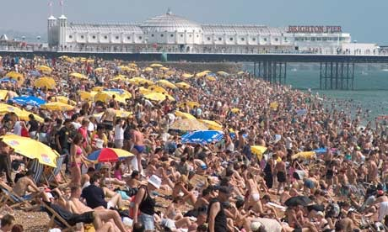

Limits to Human Capacities
In the Anthropocene, humankind has transformed from a normal terrestrial animal to a unique global phenomenon.
7.5+ billion humans
Over half live in urban hives of millions of individuals

Slide 4
Limits to Human Capacities
Digital media and rapid transportation now connect humanity economically, socially, and culturally in a planetary network of multiple, cross-cutting ties.
A highly complex social-natural system
Unprecedented for any organism in earth's history.

Slide 5
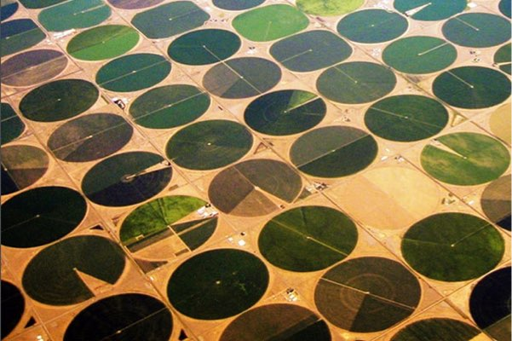
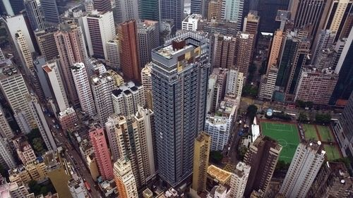
Next Generation Modeling for Planetary Managers
In an Earth dominated by rapidly changing, telecoupled human and biophysical processes…
we can no longer depend on human intuition and simple statistics to plan our future.
Need next generation data-driven science and modeling to help us sustainably manage dynamics of a planetary socio-ecological-technological system

Slide 6
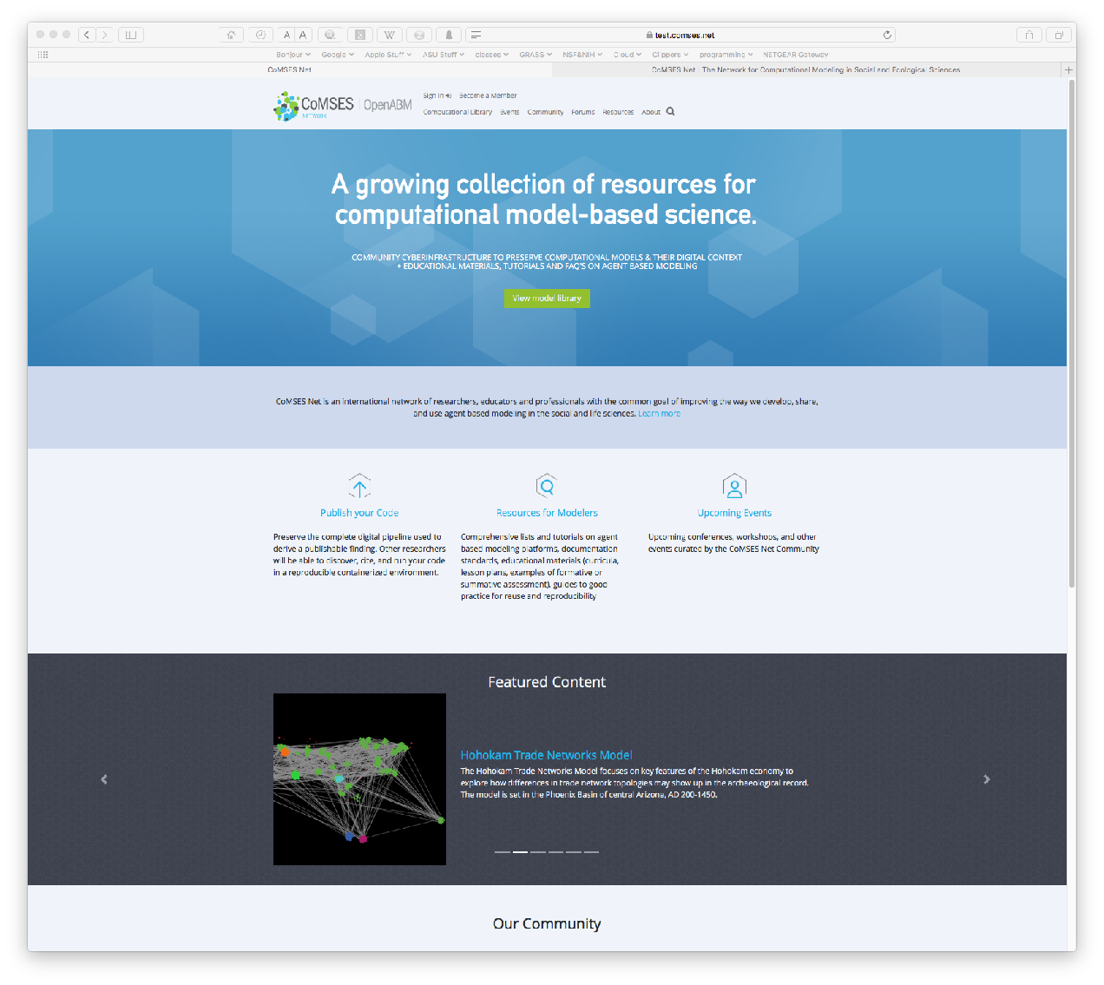
CoMSES Net
An international scientific network of researchers, educators and professionals with the common goal of improving the way we develop, share, and use computational modeling in the social and ecological sciences
Long term goal of supporting and enabling nextgen modeling of complex and interacting social and natural systems
http://www.comses.net

Slide 7
CoMSES Net History
Pilot project (OpenABM Consortium) 2006-2009:
Recognized growing importance of computational modeling across sciences
How can computational modeling become used more effectively across the social and ecological sciences?
Value of new ways of sharing knowledge
CoMSES Net founded 2009 as NSF Research Coordination Network
Develop interactive, online library for publishing computational model code from scientific research
Education and training programs to enable more effective use of modeling in social and ecological sciences
Promote common standards for description and metadata for computational models
Create online publication to support modeling science community

Slide 8

CoMSES Net History
Joined NSF West Big Data Hub as a Spoke in 2016
Work with western regional and international partners to develop community-wide strategies and standards for promoting reproducible science
Create a bibliometrics database of publications in modeling science to monitoring the state of code archival and provide the basis social incentives that can nudge scientists to publish code and associated documents
Develop protocols and cyberinfrastructure to facilitate model code publishing, enhance model reusability, and enable professional recognition for publishing model code

Slide 9
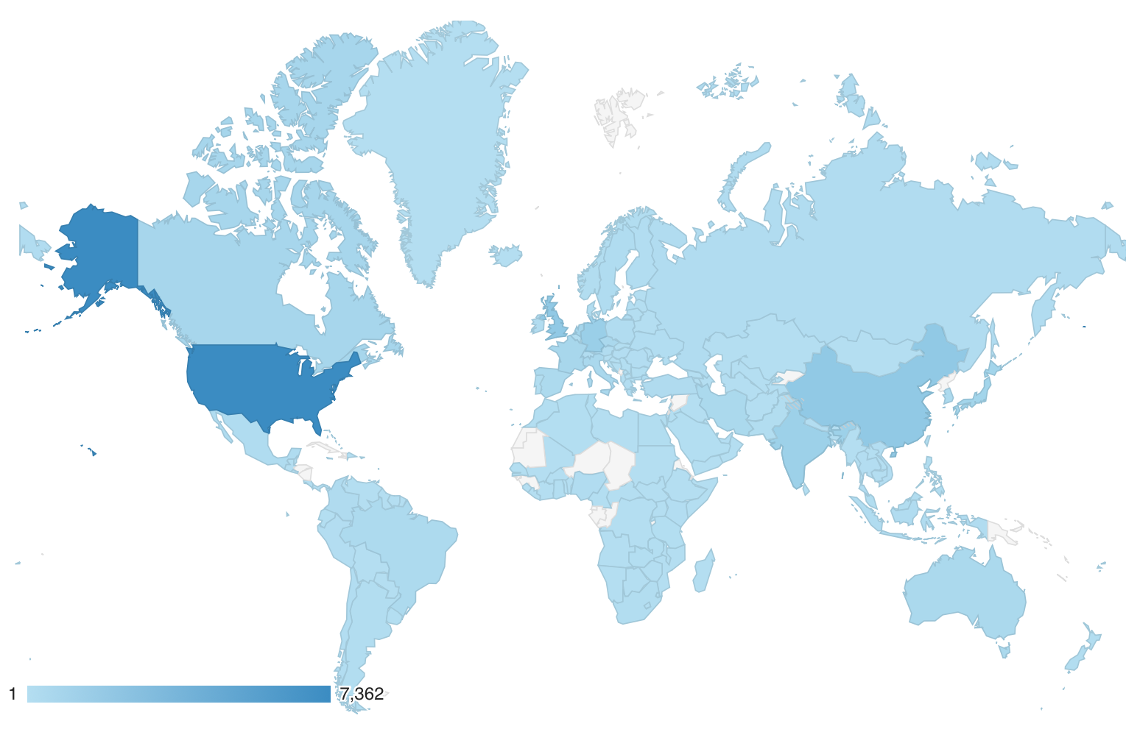
International Scientific Network
2630 members
1981 basic members
649 full members
Past 12 months
24,531 users
162 countries
CoMSES.net use in past year by country

Slide 10



Our Community
Novice / Neophyte Modelers
Access to useful educational materials and the computational modeling library
Accessible material and connections to a welcoming community of experts
Established Computational Modelers
Build on each other’s shared experiences, establish community standards
https://www.comses.net

Slide 11
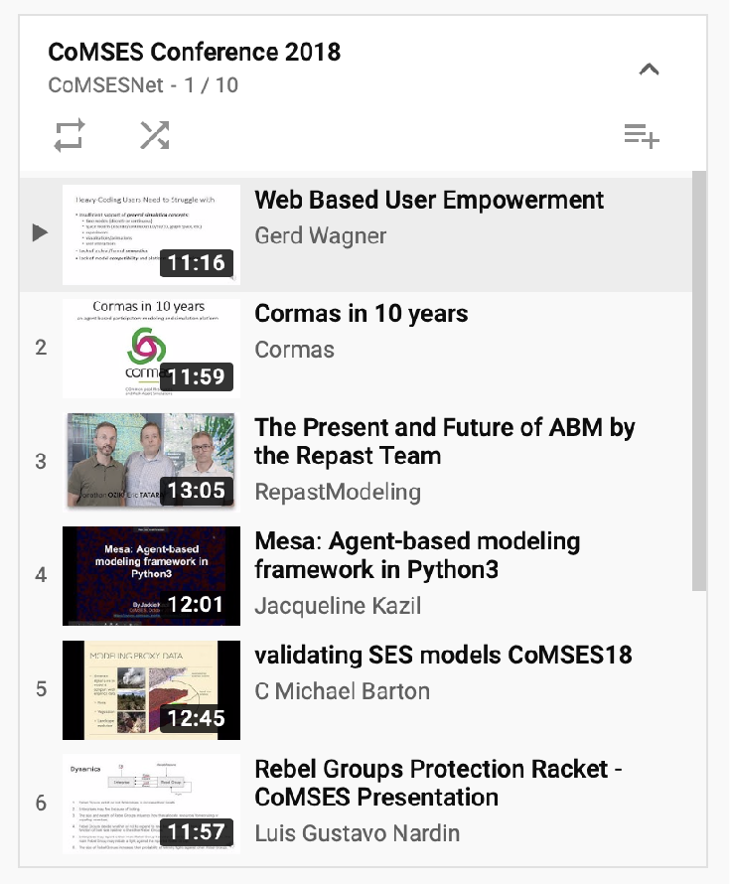
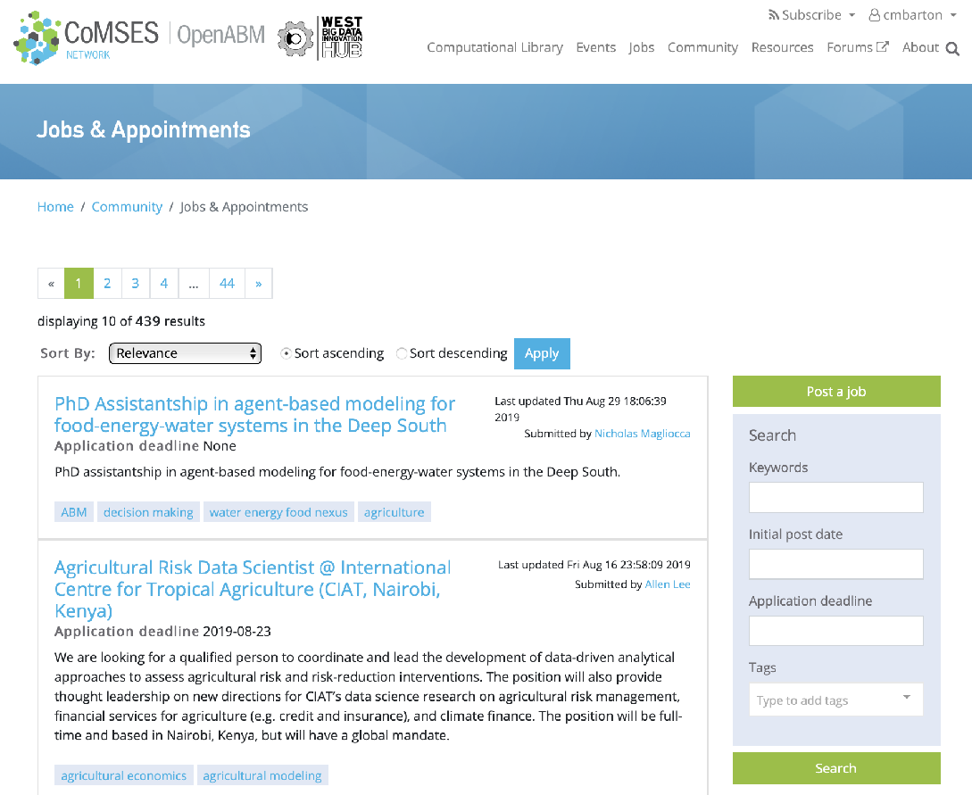
Resources for Professional Development
Annual virtual conference and archived videos
Professional positions forum
Events calendar
Compendium of modeling journals and platforms
https://www.comses.net/conference/
https://www.comses.net/jobs/

Slide 12
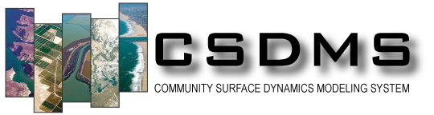

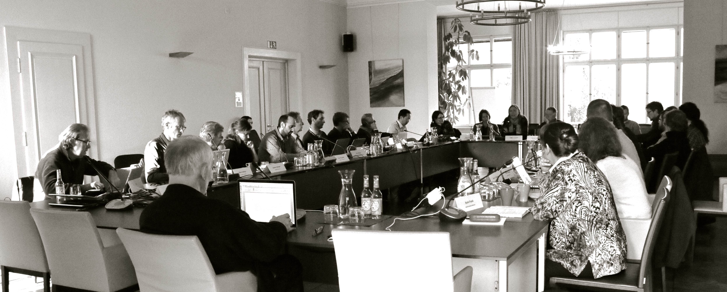
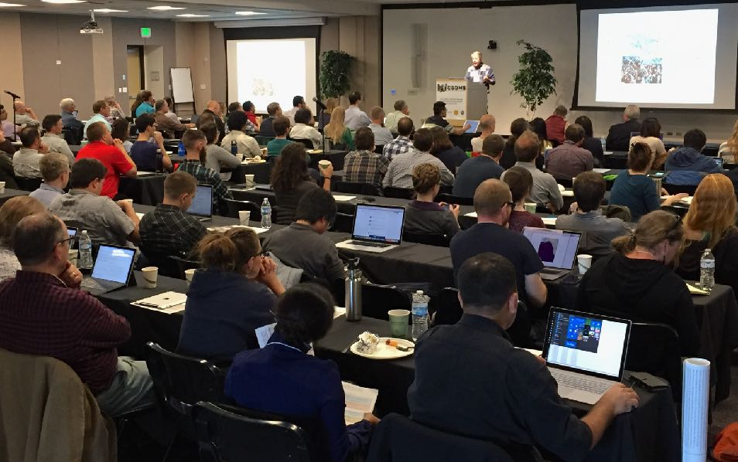
Collaborations and Partnerships
Working with other scientific communities to advance best practices, transparency, and modeling science
co-organizing international meetings on the future of Earth systems modeling with AIMES (Analysis, Integration and Modelling of the Earth System, Future Earth) https://aimesproject.org
co-organizing annual meeting of CSDMS (Community Surface Dynamics Modeling System) http://csdms.colorado.edu

Slide 13
Bibliometrics and State of Model Code Access
7195 publications from ISI Web of Science reviewed (1990-2018)
Collected bibliometric metadata
Recorded whether code is accessible and where
Modeling science increasingly important
Access to code is dismal

Slide 14
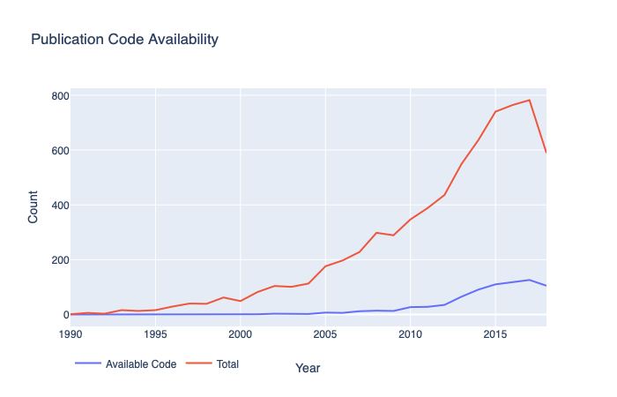
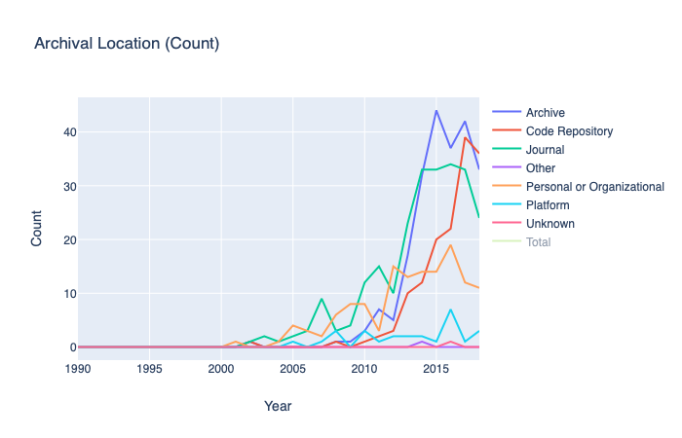
Bibliometrics and State of Model Code Access
Code available for <11% of modeling science papers overall (about 15% for NSF funded research)
Improvement over time, but only available for <20% of most recent papers
An even smaller number available in a publicly accessible, persistent repository
We are working to change this

Slide 15
Future Directions: Access & Transparency
Bibliometrics project
Use the project to improve access to model code
Open bibliographic database with links to model code, where available
Use results to contact modeling scientists and encourage them to make their code available
Dear Michael Barton,
We are contacting you on behalf of CoMSES Net, an open research community dedicated to advancing transparency in scientific computing. Supported in part by the United States National Science Foundation’s Big Data initiatives, our mission includes improving practices around documenting, preserving, citing and sharing computational models in the social and ecological sciences…
We were unable to locate the model source code referenced in the publication(s) listed above at a publicly available URL and hope to learn from you whether the model source code is publicly available…
If your model source code is not yet archived, we encourage you to do so at a trusted DOI issuing digital repository. We maintain a curated list at https://www.comses.net/resources/trusted-digital-repositories/ that you may find useful.

Slide 16
Future Directions: Access & Transparency
Remixed Open Science Framework’s Open Materials Badges into an "Open Code" badge that can be attached to publications with archived code according to community standards
Awarded to publications that archive the source code needed to reproduce their reported results in an open access, trusted digital repository that adheres to best practices for software citation and FAIR data.

Slide 17
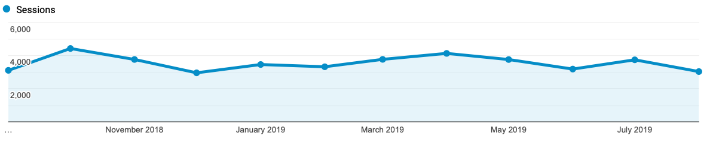
Open Access Model Library
697 published models in CoMSES Computational Model Library
120 new models published in past year
46,317 model downloads in past year
100+ new peer review requests, 54 models passed
Passing peer review grants a citable DOI that points at a durable metadata landing page for a specific, frozen version of that model

Slide 18
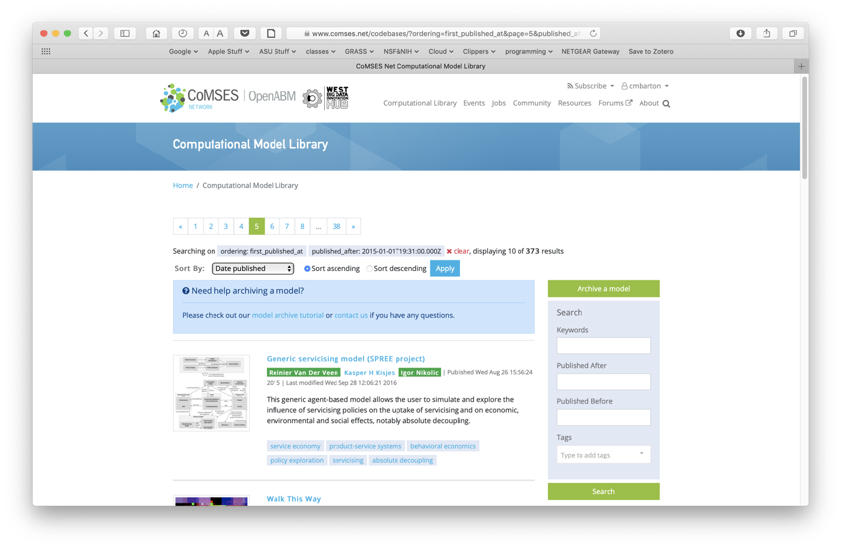
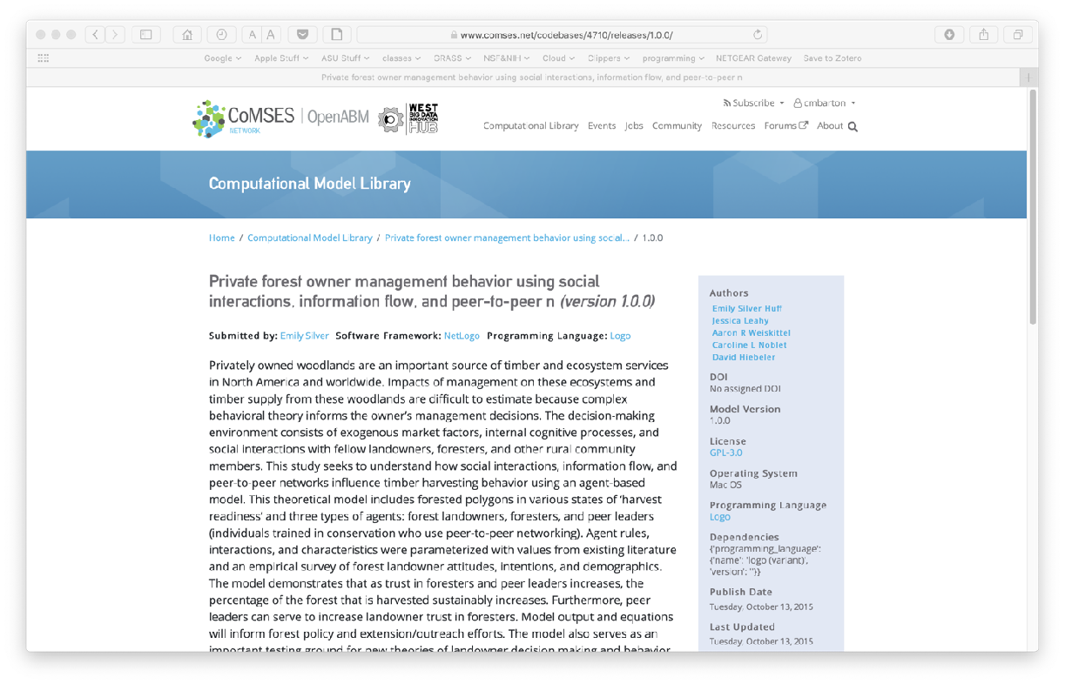
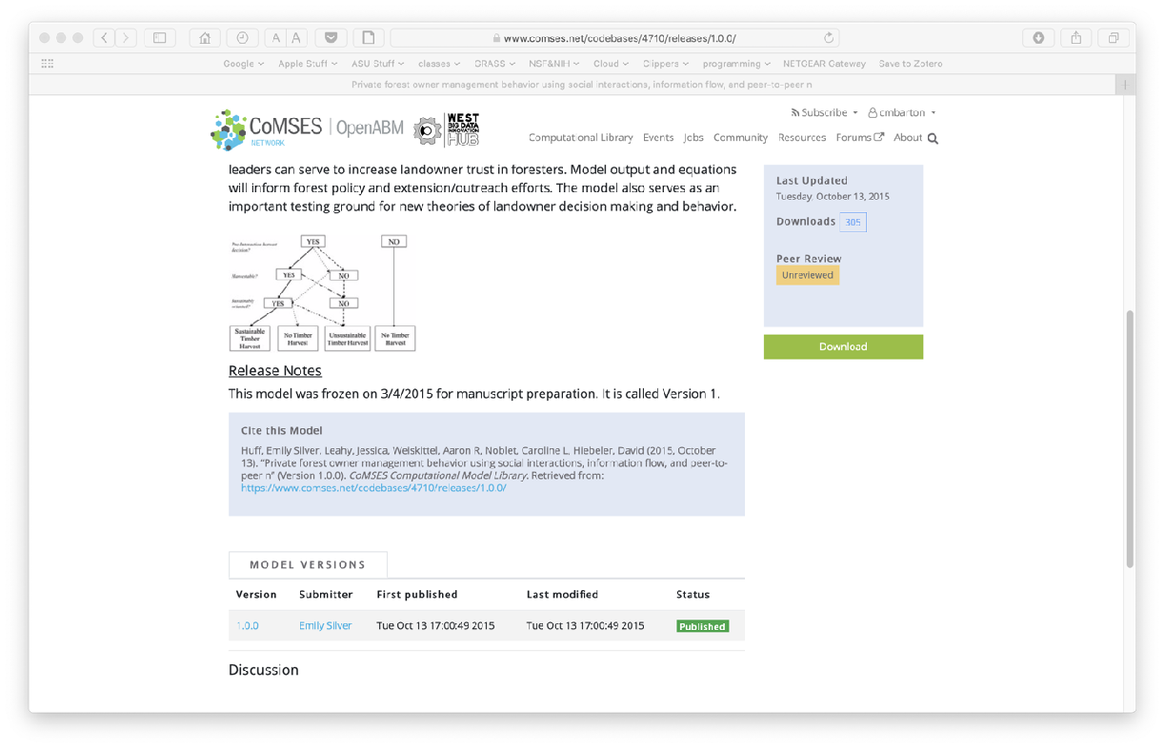
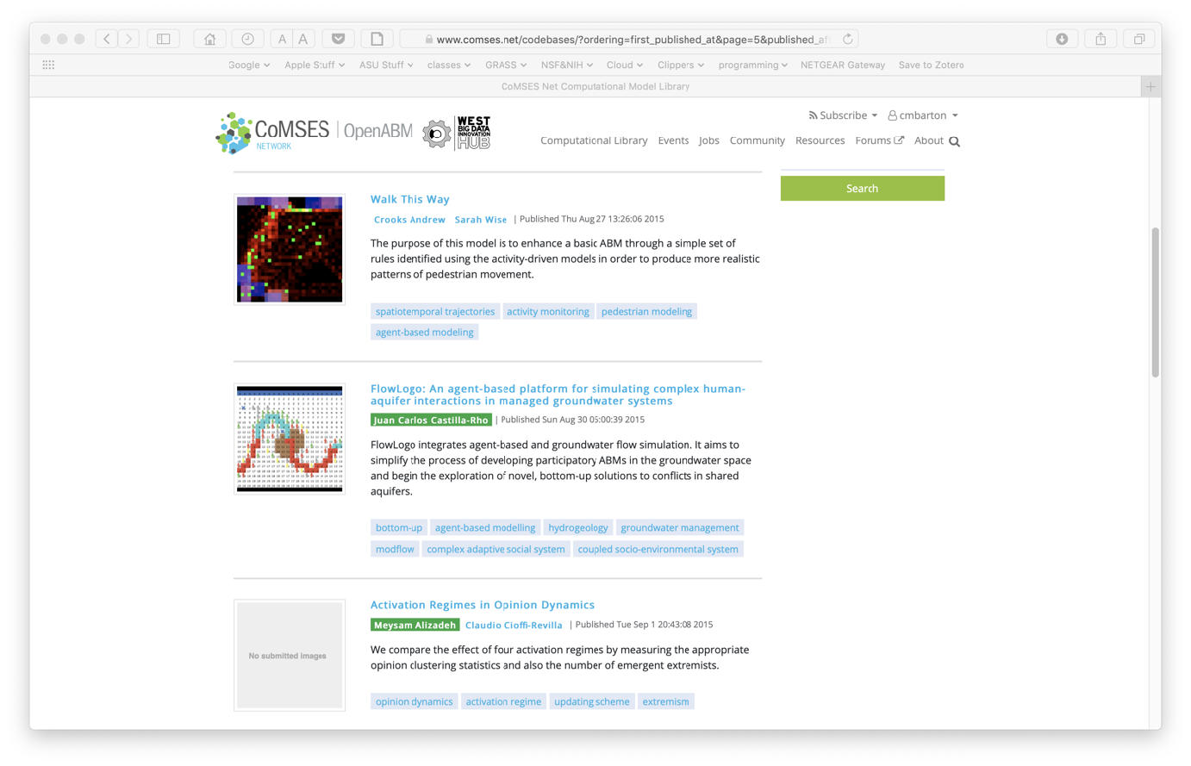
Open Access Model Library

Slide 19

Future Directions: Reusability and Workflows
Develop and promote reusability standards and software support
Develop tutorials and supporting software to augment existing codebases for widely used model platforms (e.g., NetLogo, Mesa, RePast, Mason, R) for containerization, continuous integration, automated testing, and other software engineering good practices
Include all correctly versioned data and software dependencies necessary to run a model in a re-executable Docker container image
Include documentation/description needed for model reuse
Expand to open modeling science workflows with reparameterizable analyses

Slide 20
Future directions: International Initiative for an Evolving Interoperable Model Ecosystem
A grand challenge for our time is to grow scientific modeling infrastructure to understand the interactions between human and biophysical components of the earth system
Meetings in 2015-2018 organized by scientific networks, including CoMSES Net, representing modelers of societal, ecological and geophysical systems
Addressed a series of issues about how to envision and create next generation modeling for global science

Slide 21
Future directions: International Initiative for an Evolving Interoperable Model Ecosystem
How can we enable integrative modeling of human and biophysical systems and their processes?
How can we enable flexible modeling across scales?
How can we incorporate diverse conceptual approaches to modeling human-earth system dynamics?
How can we develop scientific resilience for questions we cannot yet anticipate and unknown future challenges?
How can we democratize advanced modeling technology to make it widely accessible to a global community?

Slide 22
Future directions: International Initiative for an Evolving Interoperable Model Ecosystem
How can we establish, maintain, and manage an international scientific agenda for integrative modeling of human and Earth systems?
How can we build new capacity in data science and modeling at scales from local to planetary?
How can we build from current technologies, yet surpass limitations of legacy systems and explore new directions?

Slide 23
Future directions: International Initiative for an Evolving Interoperable Model Ecosystem
Create socio-technological environment to support an ecosystem of potentially interoperable models created by diverse individual scientists and teams
Enable representation of human <-> biophysical systems at multiple scales, and to address diverse questions
Parallels organization of real world, complex socioecological systems we seek to study

Slide 24
Future directions: International Initiative for an Evolving Interoperable Model Ecosystem
Model interoperability not a new idea and widely seen as desirable for future modeling and simulation
…but has been difficult to operationalize
Recent maturation and convergence of technologies to advance this goal
Platform independent, reusable, interoperable modeling
Encapsulation for platform independence
Standard API wrapper with shared ontology for multi-model integration
Web services wrapper to run in cloud
Reproducible workflow supervisor for complex model integration
Build tools that help existing models conform to integration standards with minimal changes

Slide 25
Future directions: International Initiative for an Evolving Interoperable Model Ecosystem
Technology is helpful but not sufficient
Evolving modeling ecosystem needs scientific institutions to:
develop software standards for modeling best practices that can apply broadly across multiple global scientific communities
disseminate information about standards to diverse stakeholder communities
administer standards, including evaluation and certification of software
provide education, training, assistance, and incentives to modeling scientists
Requires coordinated, international effort from social and natural science communities
A social challenge as much or more than technological

Slide 26
Future directions: International Initiative for an Evolving Interoperable Model Ecosystem
CoMSES Net coordinated a meeting in June 2018 to discuss action items of workshops of preceding two years
Attended by representatives from scientific networks representing thousands of modeling scientists across social, ecological, environmental, geophysical sciences (AIMES, CoMSES, CSDMS, iEMSS, ISEM, OpenMI, EPA, others). Joined by more organizations in 2019
Proposed a federated meta-organization to develop, disseminate, and administer community standards for: accessibility, documentation, reusability, and interoperability for modeling science
Open Modeling Foundation: support a self-organized, evolving modeling ecosystem – sign up at https://openmodelingfoundation.org/open-letter/

Slide 27

Future directions: International Initiative for an Evolving Interoperable Model Ecosystem
Ecosystem of interoperable models with the potential to serve as building blocks for new integrative modeling of human-earth systems
Flexibility, scalability, and ability to rapidly incorporate new concepts and technologies
Feedbacks in integrative human and earth system models can reveal new dynamics (e.g., tipping points) and better measure of uncertainty in complex, coupled system behavior
hydrology
model
markets
model
livestock
model
crop
model
soil
model

Slide 28
Future directions: International Initiative for an Evolving Interoperable Model Ecosystem
CoMSES Net is coordinating the Open Modeling Foundation initiative, in partnership with other modeling science groups around the world.
Hold workshops to introduce OMF initiative to broad array of stakeholders in order to build an international community
Develop and disseminate proposed standards and invite community input via web, white papers, publications
Develop and deploy proof-of-concept technology to enable existing models conform to standards with minimal changes
Establish and administer certification program for models that meet OMF protocols
Partner with journals and funding agencies to incentivize participation
Seek funding to carry out mission and goals

Slide 29
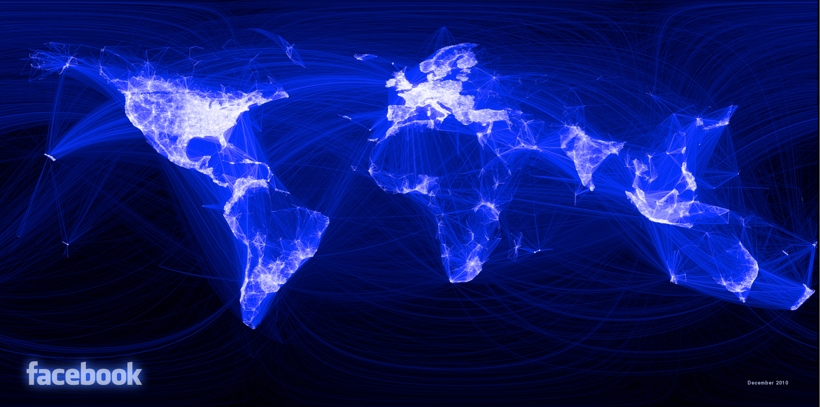
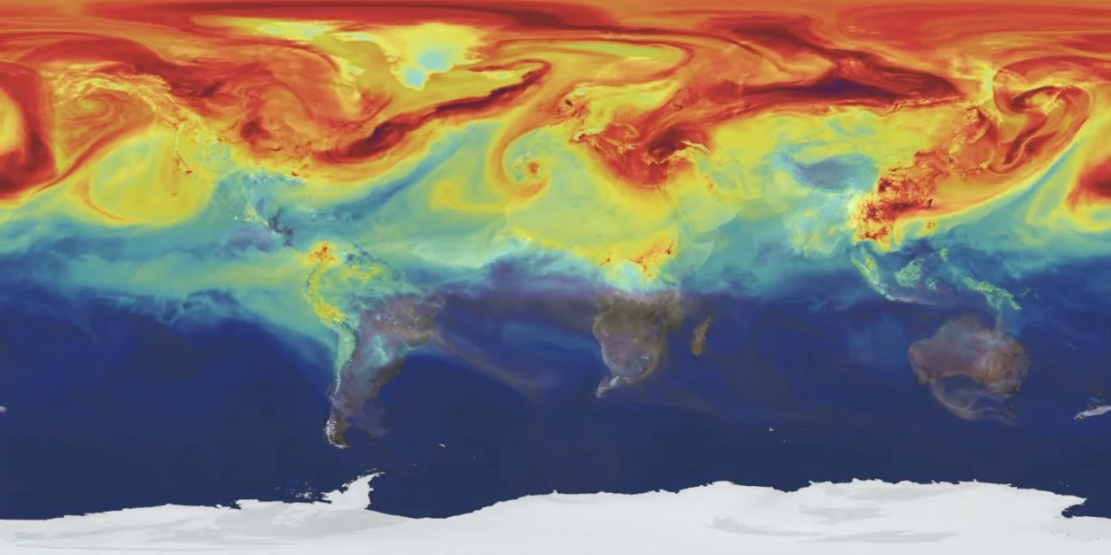
CoMSES Net and Global Modeling Science
Actively partnering with researchers and stakeholders in the US and abroad
Supporting a global community of modeling scientists with cyberinfrastructure and incentives for best practices
Advancing critical modeling science we need to better understand our planet and manage it sustainably into the future

